Slide 1
Case 78 Match 1 SOX10
Jack Ouyang

Slide 2
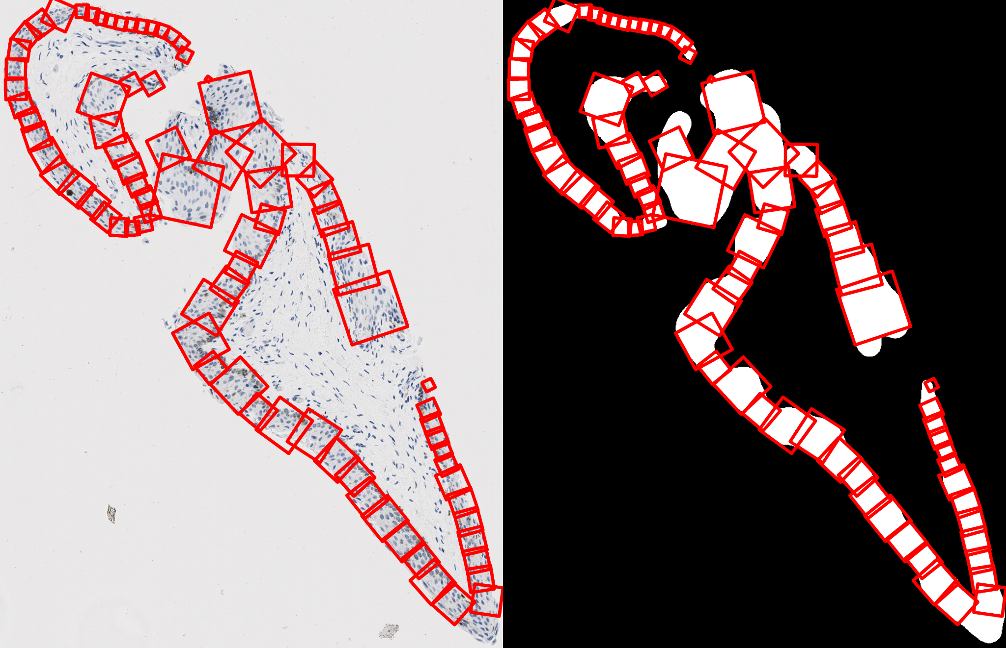

Slide 3
